Slide 1
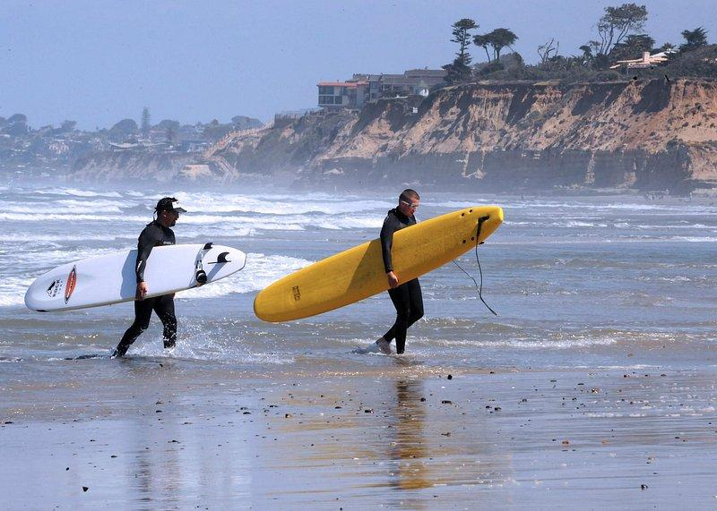
Ettore, Matthew, Olga, Olivia, Racheal
MORE > MOORE
Shark Attack Analysis 19.01.24

Slide 2
Context
300 000
people participate in water sports (USA,
Australia, South Africa) every year
1 in 500
are attacked by a shark
7% of those attacks are fatal

Slide 3
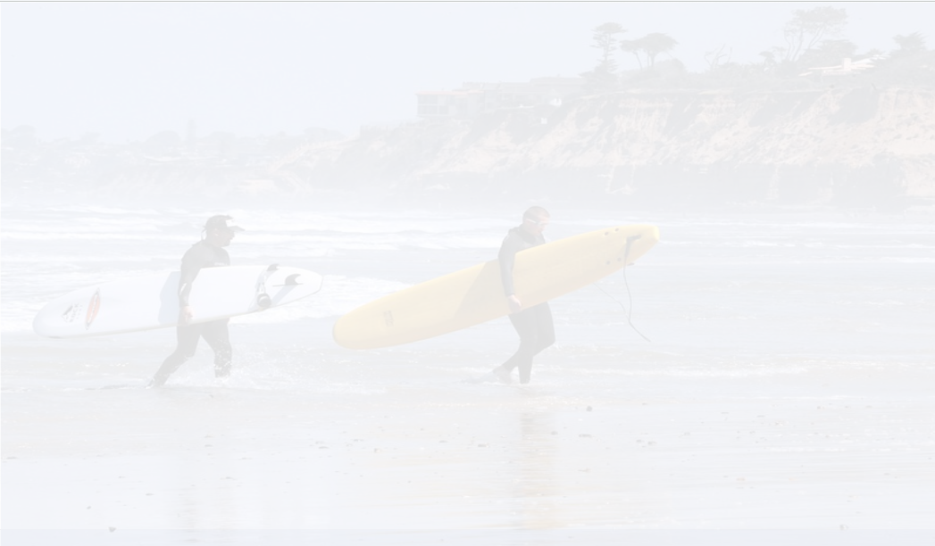
Business problem
Dying customers
Poor image
Declining sales

Slide 4
Hypotheses:
#1 Certain locations are more likely to lead to shark-related fatalities
#2 Certain activities are more likely to lead to shark-related fatalities
#3 Certain age groups are more vulnerable to shark-related attacks
#4 Certain months are more dangerous when considering shark-related fatalities

Slide 5
Data cleansing and manipulating activity:
Examples:
made spelling uniform
cleansed null values
  removed
  replaced with mode and median
grouped activities to remove duplicates
added additional columns:
  activity risk scale (our perception thereof)
  injury severity
built risk calculator

Slide 6
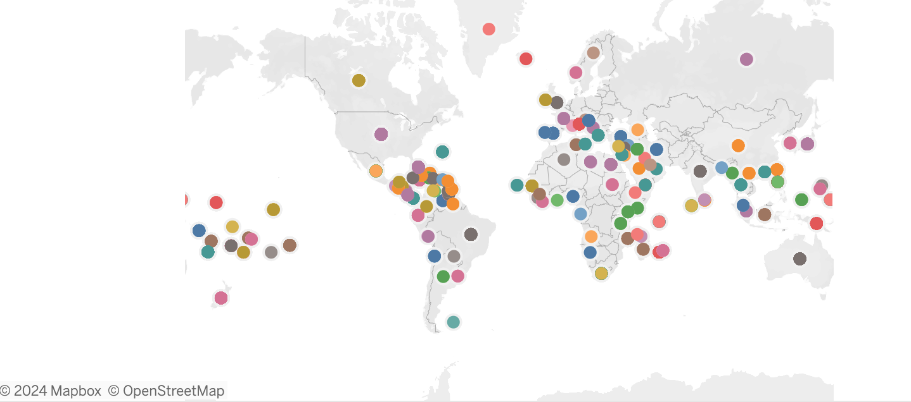
Hypothesis 1: Certain locations are more likely to lead to shark-related fatalities
Visualisation of all shark attacks globally for all time

Slide 7
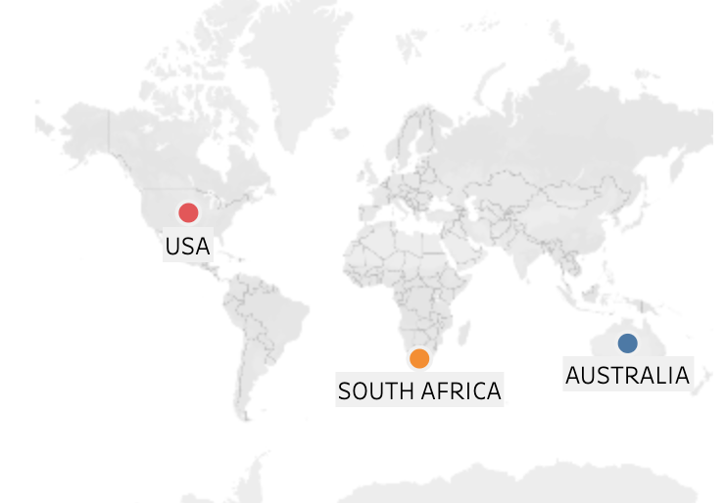
Hypothesis 1: Certain locations are more likely to lead to shark-related fatalities
Correlation coefficient (attacks, fatalities)
Australia = 0.96
USA = 0.96
South Africa = 0.89
By isolating USA, Australia and South Africa (top 3 countries for shark attacks), we can sample 2/3 of the data ‘population’ (4610/6880 instances):

Slide 8

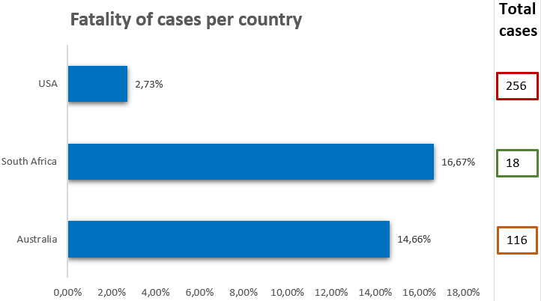
Hypothesis 1: Certain locations are more likely to lead to shark-related fatalities

Slide 9

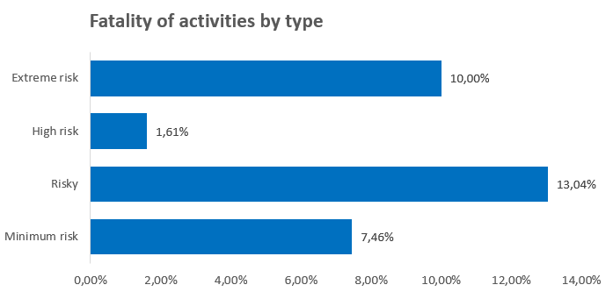
Hypothesis 2
Certain activities are more likely to lead to
shark-related fatalities
Extreme risk - underwater activities (e.g. diving)
High risk - fishing
Risky - on-water activities (e.g. surfing, boarding)
Minimum risk - everything else

Slide 10
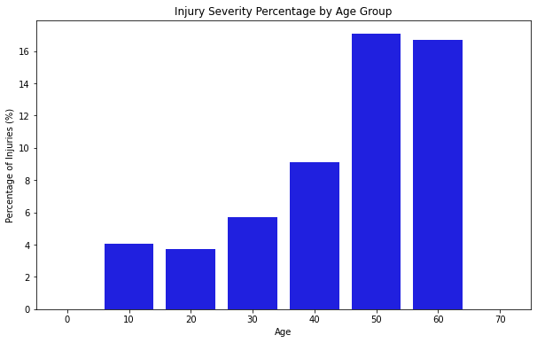
Hypothesis 3
Certain age groups are more vulnerable to shark-related attacks

Slide 11
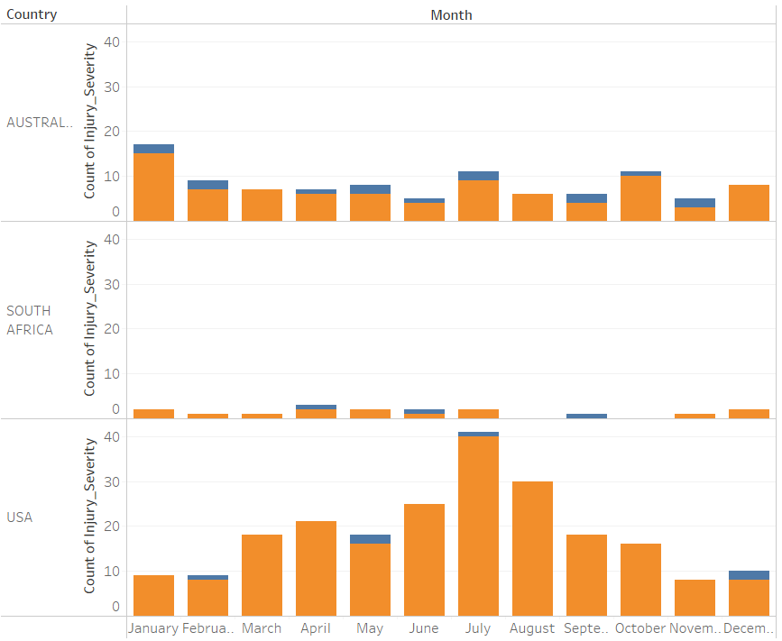
Hypothesis 4
Certain months are more dangerous than others when considering shark-related fatalities

Slide 12
Hypotheses:
#1 Certain locations are more likely to lead to shark-related fatalities VALIDATED
Action: Increase tour offering in the USA
#2 Certain activities are more likely to lead to shark-related fatalities FAILED
Action: Further risk assess activities
#3 Certain age groups are more vulnerable to shark-related attacks VALIDATED
Action: Introduce protective measures for kids and over 50s
#4 Certain months are more dangerous when considering shark-related fatalities VALIDATED
Action #1: Improve marine monitoring in summer months (i.e. drones) due to increased demand for watersports
Action #2: Further research what drives increase in attack count in summer months

Slide 13

HOW MIGHT WE MITIGATE RISK?
Increasing transparency of risk through risk calculator

